Slide 1
Requirements Management

Slide 2
What is Requirements Management?
RM provides capabilities for capturing, managing and tracing requirements through out the project lifecycle. You can use the Requirements Management (RM) application to define, manage, and report on requirements in a lifecycle development project. Below are some functionalities of Requirements Management:
Creating and defining requirements.
Creating collections and reviews.
Managing requirements in CLM.

Slide 3
What can we do in Requirements Management?
We can use rich-text artifacts to define requirements and requirements documents.
We can also create and link to supporting artifacts, such as business process diagrams, use-case diagrams, and UI sketches, to elaborate requirements and put them in the broader context of the system and business processes.
We can manage requirements by using traceability links, tags, attributes, filtering, and dashboards.
With these capabilities, we can create relationships between requirements and other artifacts, categorize requirements, assign properties to requirements, and monitor relationships and status among team applications.

Slide 4
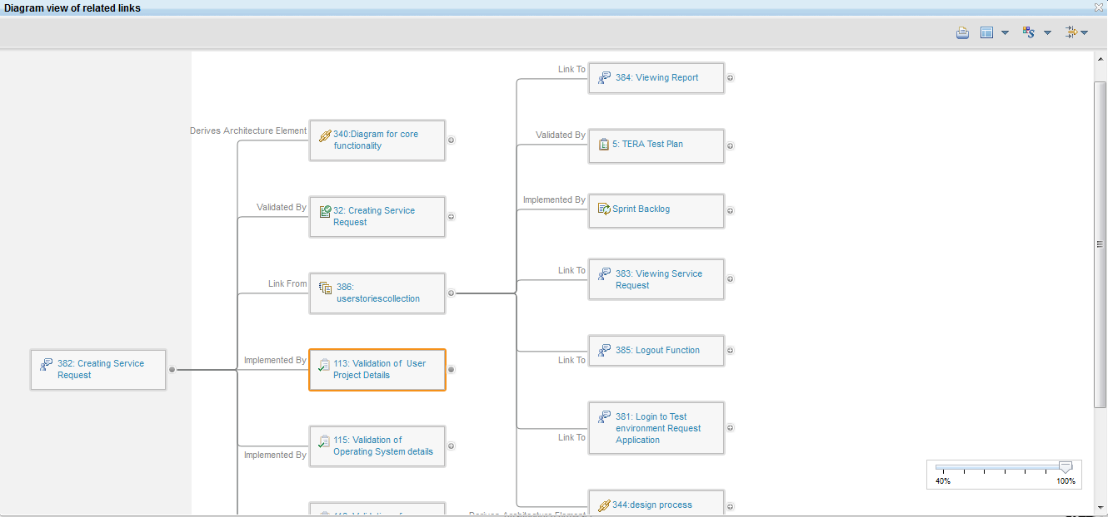
A View of Traceability in RM
In the above image the requirement “Creating Service Request” is linked to a design diagram “Diagram of core functionality” from where it derives the functionality. Again it is connected to several test plans and those plans are validating the functional implementation of the requirement. It is also connected to some tasks of change and configuration management which are implementing the requirement.

